Slide 1
Wildfire Smoke Impact on Bozeman, MT
Presentation to the City Council by –
Raman SV
Concerned Citizen, Data Scientist

Slide 2
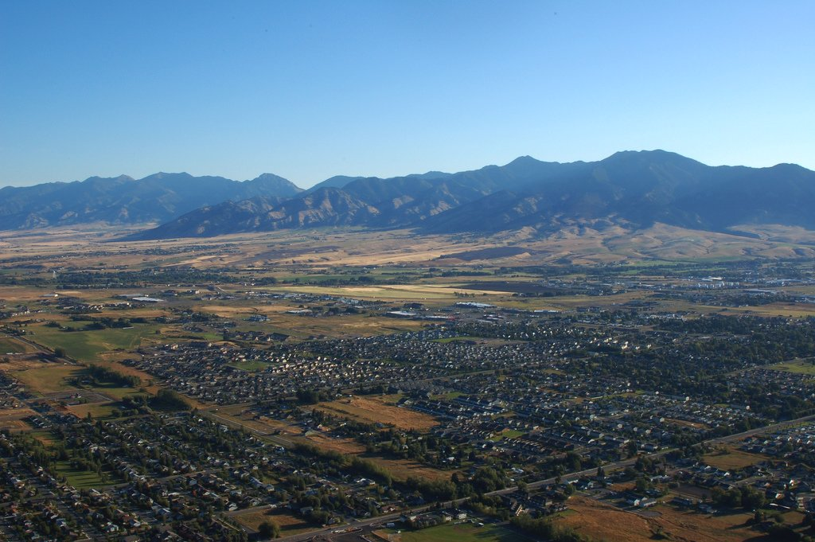
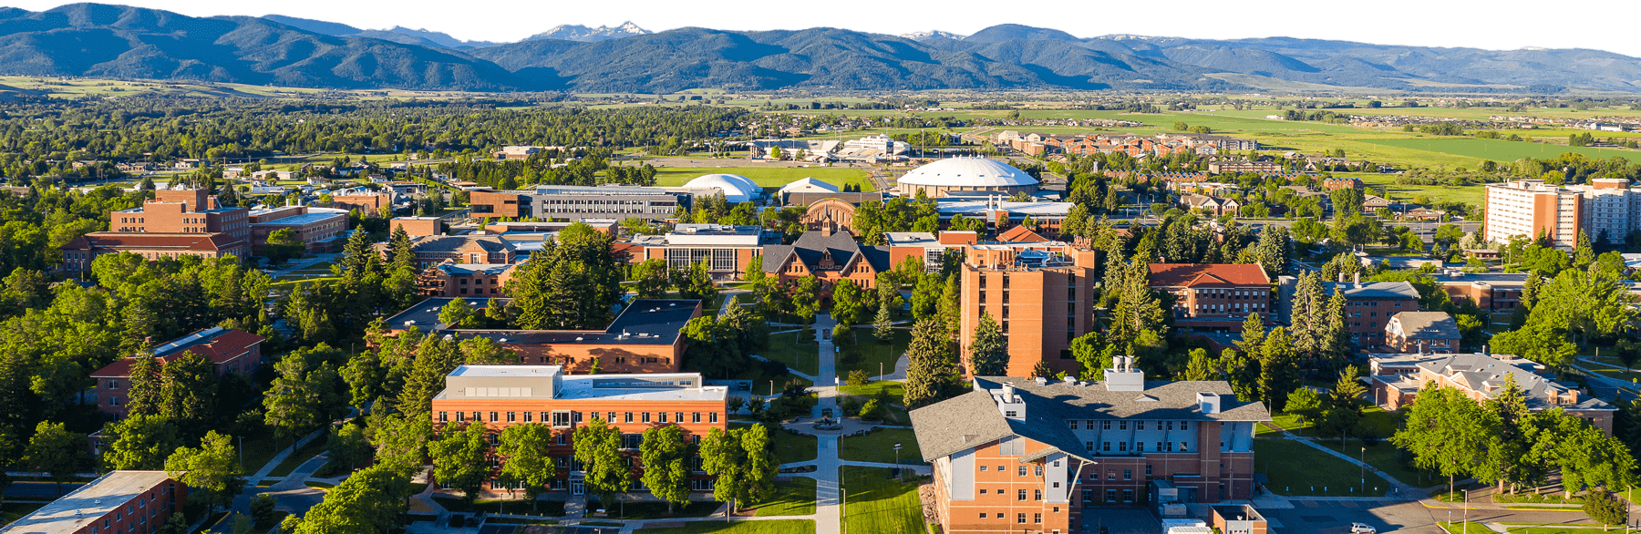
Bozeman, Montana

Slide 3
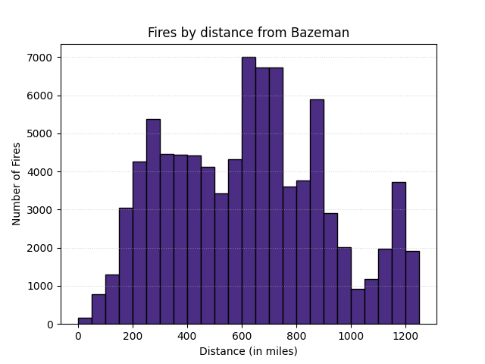
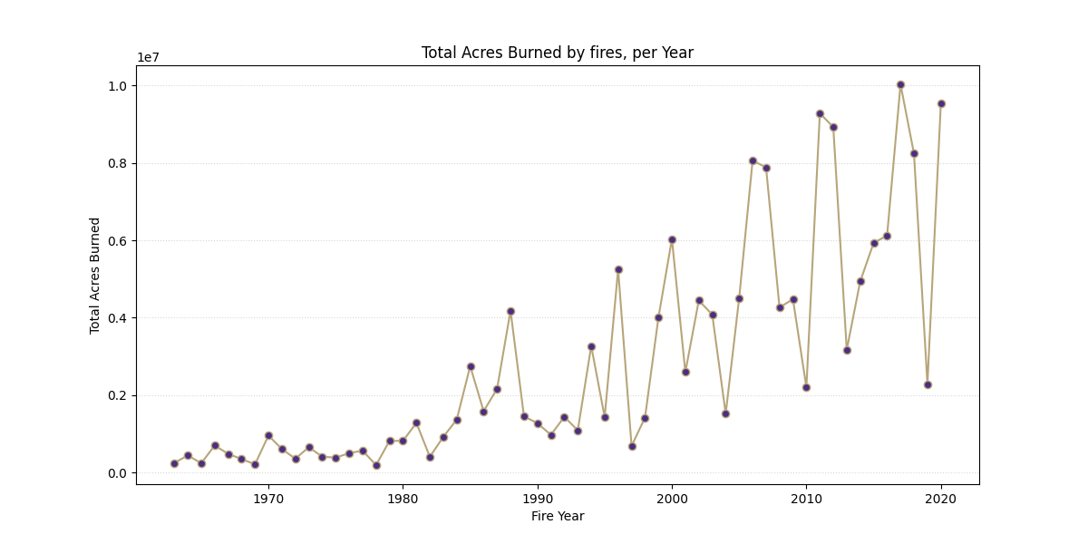
There is no smoke without fire

Slide 4
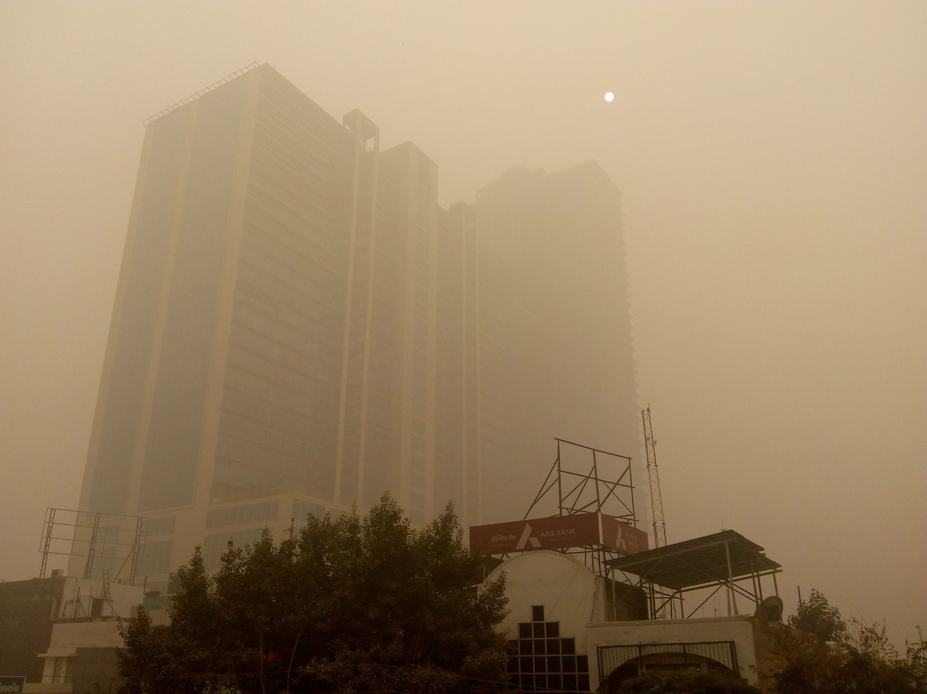
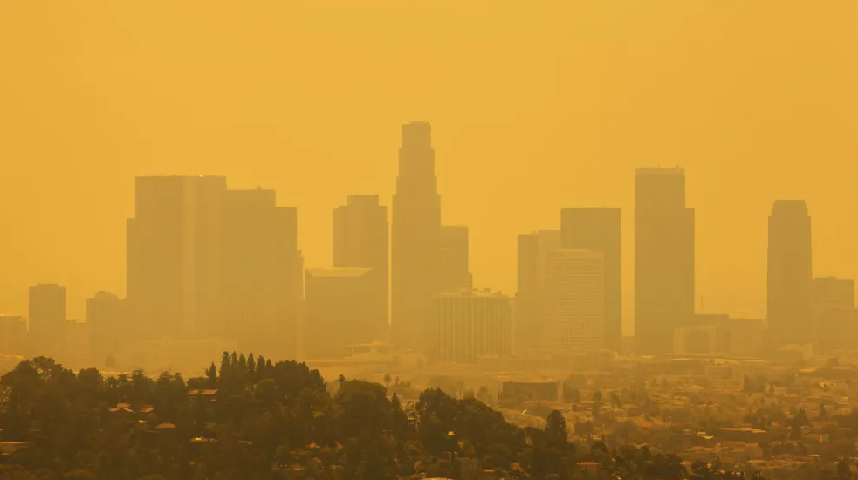
Why do we care?

Slide 5
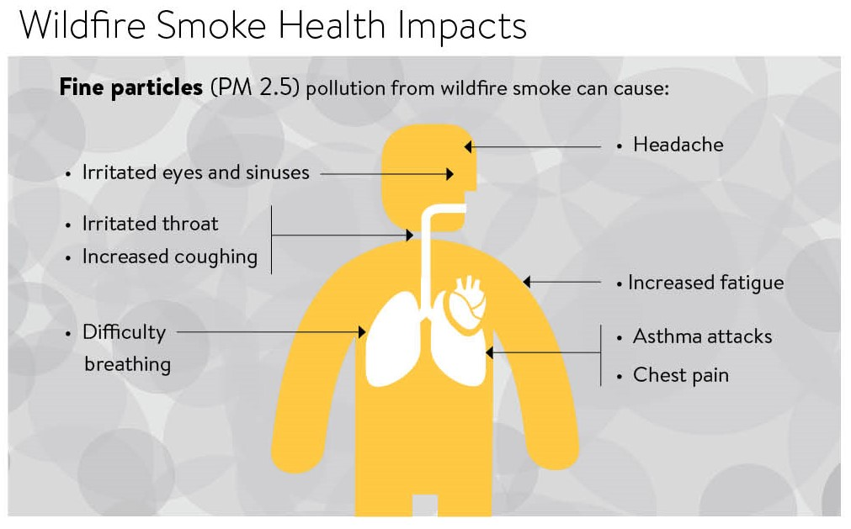
Smoke Impact!
The particles in wildfire smoke are no larger than one third the diameter of your hair and hence, they could lodge deep in our lungs.
This pollution can trigger or cause –
Asthma attacks
Heart attacks
Strokes
Studies of children in California found that children who breathed the smoky air during wildfires had more coughing, wheezing, bronchitis, colds, and were more likely to have to go to the doctor or to the hospital for respiratory causes, especially from asthma.
Source – American Lung Association
Image source – Minnesota Dept. of Health

Slide 6
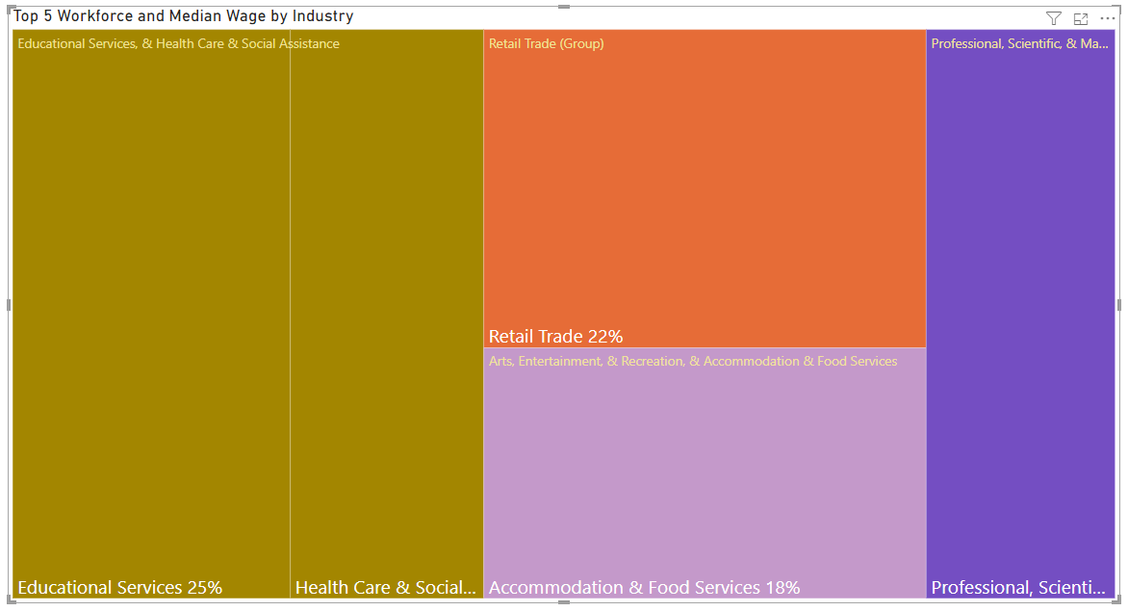
Impact on Bozeman

Slide 7
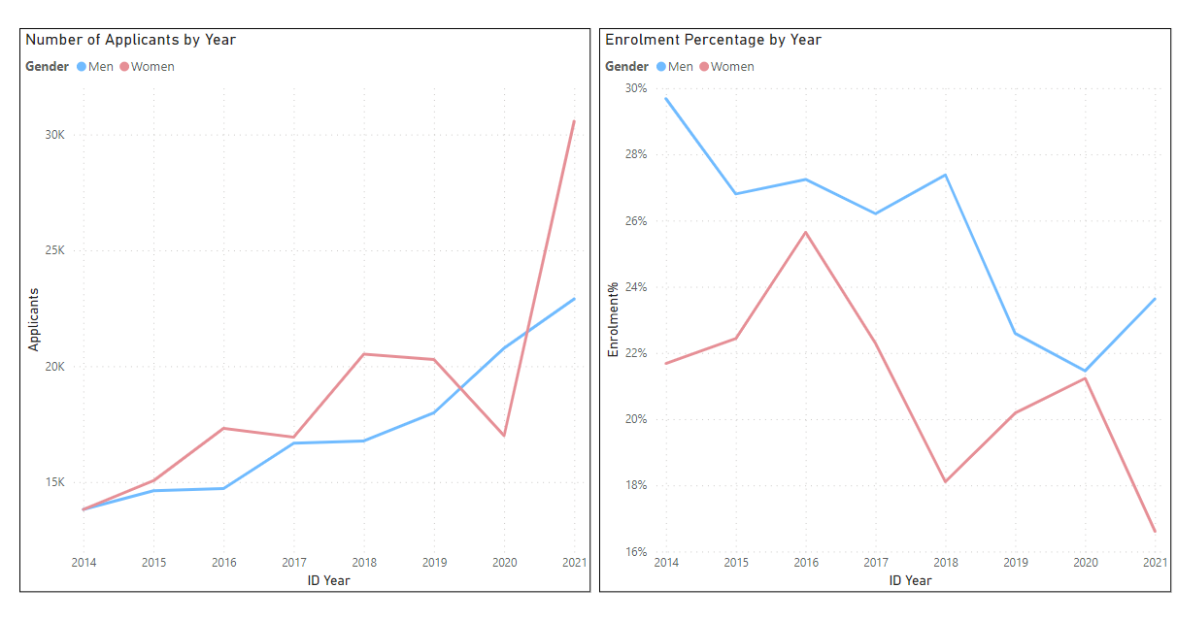
MSU – a trend

Slide 8
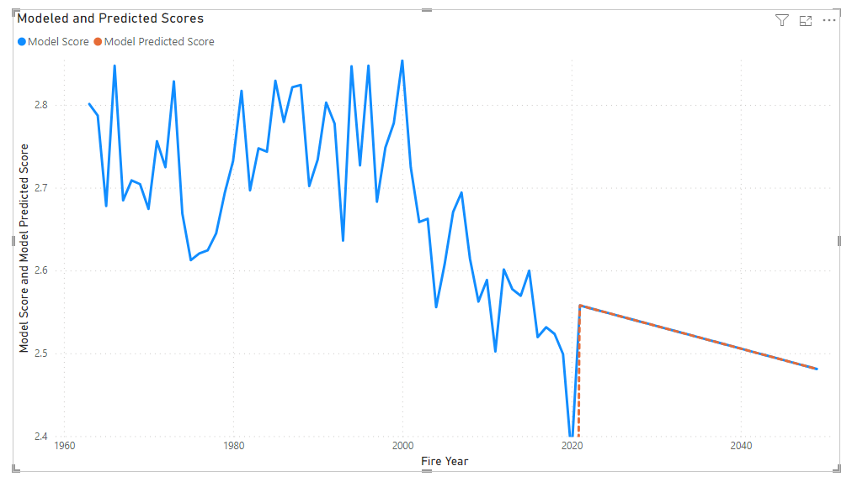
Model Scores and Prediction

Slide 9
Model Composition
Scoring is based on 5 components –
Fire Type (Wildfire, Unknown - Likely Wildfire, Prescribed Fire, Likely Wildfire, Unknown - Likely Prescribed Fire)
Hectares affected (sorted by quintiles)
Area affected by fire (sorted by quintiles)
Proximity of fire to Bozeman (within 100 miles, 100-250mi, 250-500mi, 500-750mi, >750mi)
Circle factor of the fire (sorted by quintiles)
Scoring weights for these factors –
Fire Type – 0.05
Hectares affected – 0.15
Area affected by fire – 0.15
Proximity of fire to Bozeman – 0.35
Circle factor of the fire – 0.3
For each fire, the weightage from above was then multiplied by number of fires in a year to derive a score for each year.
This was validated against the AQI score for each year (post 1987)

Slide 10
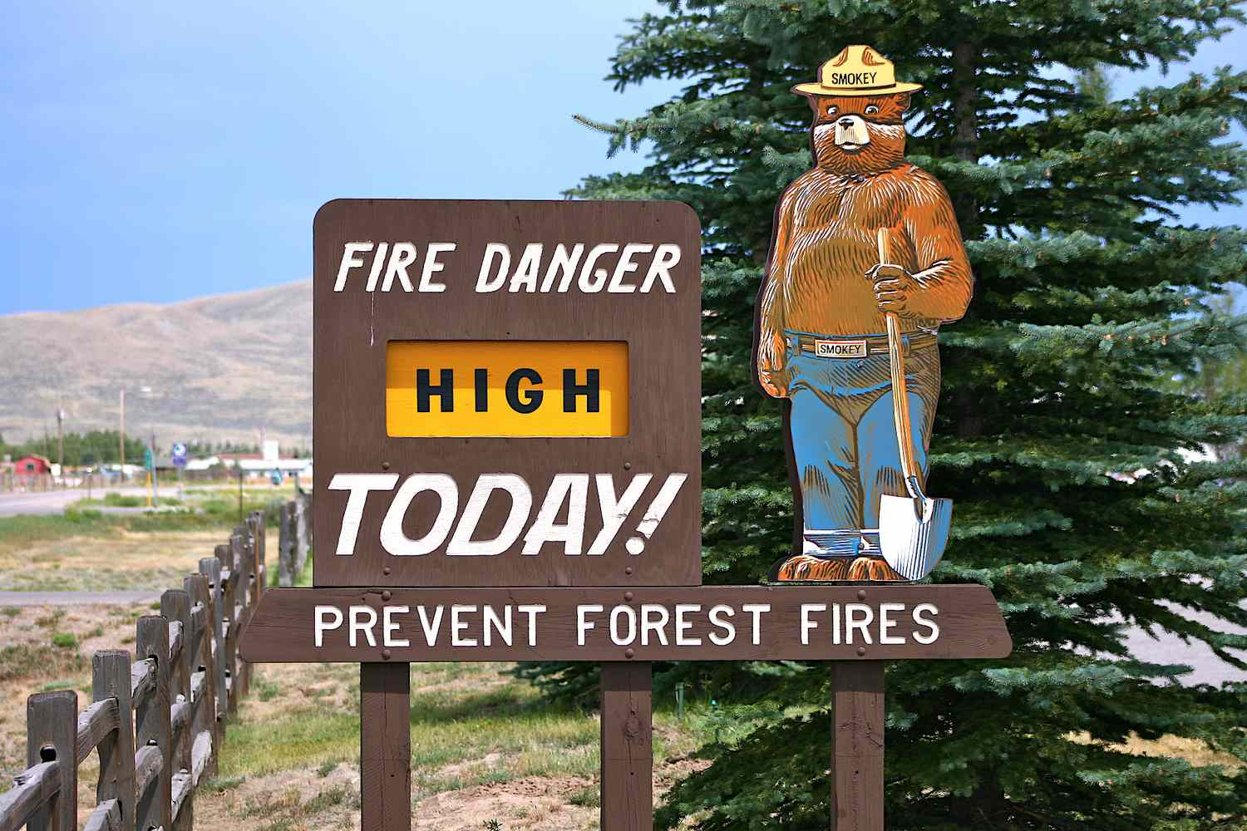
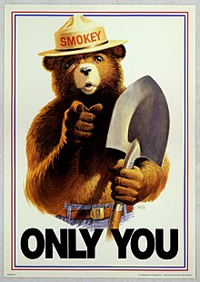
Next Steps
Community effort to mitigate impact
Educational campaigns - Bring back Smokey The Bear!
Research underlying sources, implement failsafe’s
Invest in Air Purifiers!
Protect the Students!

Slide 11
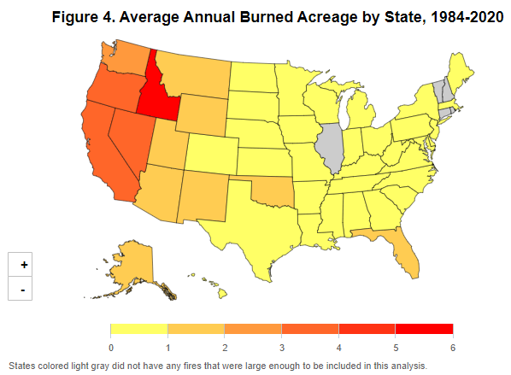
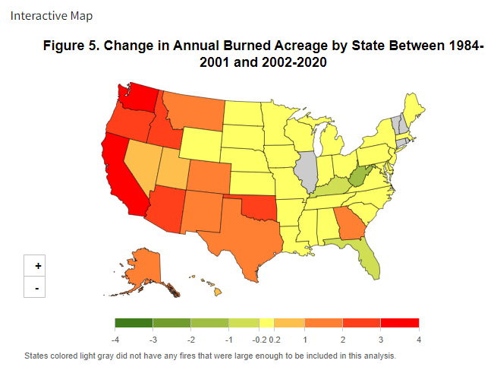
Final Thoughts – Climate Change
Source – US Environmental Protection Agency (EPA)

